Slide 1

UNIT - 3
SINGLE LINKED LIST and OPERATIONS

Slide 2
OUTCOME
Using this single linked lists topic student can able understand single linked list representation and operations of single linked list.

Slide 3
Singly Linked Lists
A singly linked list is a concrete data structure consisting of a sequence of nodes
Each node stores
next
element
link to the next node
elem
node
∅
A
B
C
D
3

Slide 4
Singly Linked Lists
A linked list allocates space for each element separately in its own block of memory called a "node".
Each node contains two fields; a "data" field to store whatever element, and a "next" field which is a pointer used to link to the next node.
Each node is allocated in the heap using malloc(), so the node memory continues to exist until it is explicitly de-allocated using free().
The front of the list is a pointer to the ―start‖ node.
4

Slide 5
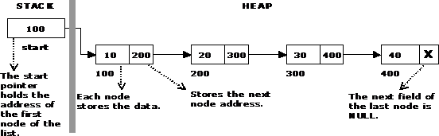

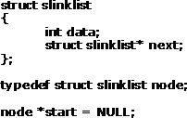

Single Linked List
5

Slide 6
Operations on Linked Lists
The basic operations of a single linked list are
Creation
Insertion
Deletion
Traversing
6

Slide 7

Creating a node
Sufficient memory has to be allocated for creating a node. The information is stored in the memory, allocated by using the malloc() function. The function getnode(), is used for creating a node, after allocating memory for the structure of type node, the information for the item (i.e., data) has to be read from the user, set next field to NULL and finally returns the address of the node.
7

Slide 8
Example
struct singlelinkedlist
{
int data;
struct slinklist* next;
};
typedef struct singlelinkedlist node;
node *start = NULL;

Slide 9
Creating a new node
node* getnode()
{
node* newnode;
newnode = (node *) malloc(sizeof(node)); printf("\n Enter data: ");
scanf("%d", &newnode -> data); newnode -> next = NULL; return newnode;
}

Slide 10

Creating a single linked list

Slide 11
Create a new linked list
void createlist( int n)
{
int i;
node * newnode,* tem p;
for( i = 0 ; i < n ; i+ +)
{
newnode = get no de();
if(start == NULL)
{
start = newnode;
}
else
{
temp = start;
w hile(temp - > next ! = NULL)
temp = temp - > next;
temp - > next = newnode;
} }
}

Slide 12
Inserting a node
Inserting a node into a single linked list can be done at
Inserting into an empty list.
Insertion at the beginning of the list.
Insertion at the end of the list.
Insertion in the middle of the list.

Slide 13
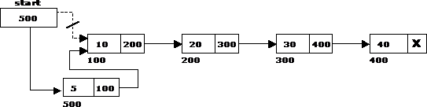
Inserting a node at the beginning

Slide 14
Inserting a node at the beginning
void insert_at_beg()
{
node *newnode; newnode = getnode(); if(start == NULL)
{
first = newnode;
}
else
{
newnode -> next = start;
start = newnode;
}
}
102

Slide 15
Inserting a node at the end
The following steps are followed to insert a new node at the end of the list:
This function is defined in Linked List class
Appends a new node at the end.
This method is defined inside LinkedList class shown above

Slide 16
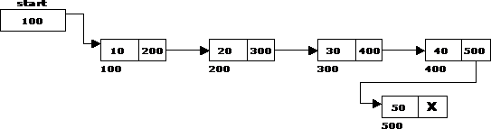
Inserting a node at the end

Slide 17
Inserting a node at the end
void insert_at_end()
{
node *newnode, *temp;
newnode = getnode();
if(first == NULL)
{
first = newnode;
}
else
{
temp = start;
while(temp -> next != NULL)
temp = temp -> next;
temp -> next = newnode;
}
}

Slide 18
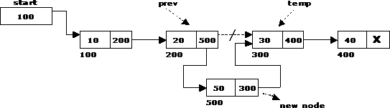
Inserting a node at intermediate position
109

Slide 19
Insert New Node at middle
void insert_at_mid()
{
node *newnode, *temp;
int val;
newnode = getnode();
printf("\n Enter the value: ");
scanf("%d", &val);
temp=first;
while(temp->next->data!=val)
temp=temp->next
newnode ->next=temp->next->next;
temp->next=newnode;
}

Slide 20
Deletion of a node
Another primitive operation that can be done in a singly linked list is the deletion of a node. Memory is to be released for the node to be deleted. A node can be deleted from the list from three different places namely.
Deleting a node at the beginning.
Deleting a node at the end.
Deleting a node at intermediate position.
110

Slide 21
Deleting a node at the beginning
The following steps are followed, to delete a node at the beginning of the list:
If list is empty then display ‘Empty List’ message.
• If the list is not empty, follow the steps given below:
temp = start;
start = start -> next;
free(temp);

Slide 22

Deleting a node at the beginning

Slide 23
Deleting a node at the end
If list is empty then display ‗Empty List‘message.
If the list is not empty, follow the steps given below:
temp = prev = start;
while(temp -> next != NULL)
{
prev = temp;
temp = temp -> next;
}
prev -> next = NULL;
free(temp);

Slide 24

Deleting a node at the end

Slide 25
Delete Node in mid based on value
void delete_at_mid()
{
int val;
node *temp, *prev;
printf("\n Enter value of node to delete: "); scanf("%d", &val);
temp = prev = start;
while(temp->next->data!=val)
{
prev = temp;
temp = temp -> next;
}
prev -> next = temp -> next;
free(temp);
printf("\n Node deleted..");
}

Slide 26
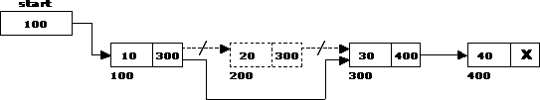
Deleting a node at Intermediate
110

Slide 27
Traversal and displaying a list
To display the information, you have to traverse (move) a linked list, node by node from the first node, until the end of the list is reached. Traversing a list involves the following steps:
Assign the address of start pointer to a temp pointer.
Display the information from the data field of each node.
120

Slide 28
Traversing
void traverse()
{
node *temp;
temp = start;
printf("\n The contents of List (Left to Right): \n");
while (temp != NULL)
{
printf("%d ->", temp -> data);
temp = temp -> next;
}
printf("X");
}

Slide 29
Quiz
1.What kind of list is best to answer questions such as: "What is the item at position n?"
Lists implemented with an array.
Doubly-linked lists.
Singly-linked lists.
Doubly-linked or singly-linked lists are equally best.
2. In a single linked list which operation depends on the length of the list.
Delete the last element of the list
Add an element before the first element of the list
Delete the first element of the list
Interchange the first two elements of the list
3. if it is assumed that X points to the first element of the list and start pointer points to beginning of the list. Code to delete X from linked list is______
X = start -> next; free(X);
start = X -> next; free(X);
start = start -> next; free(start);
X = X -> next; start = X; free(start);
4. Code to insert a new node pointed by X to be inserted at the beginning of the single linked list. The start pointer points to beginning of the list?
start -> next = X; X = start;
X -> next = start; start = X
X -> next = start -> next; start = X
X -> next = start; start = X -> next

Slide 30
Tutorial Questions
Write an algorithm to insert new node at the beginning, at middle position and at the end of a Singly Linked List.
List various operations of linked list and explain how to insert a node anywhere in the list.
Show how to reverse a single linked list.

